Slide 1
String Handling
Prepared using following Resources:
Herbert Schildt, “Java: The Complete Reference”, Tata McGrawHill Education
E Balagurusamy, Programming with Java - A Tata McGraw Hill Education
https://www.geeksforgeeks.org/java/
https://www.javatpoint.com/java-tutorial
https://www.tutorialspoint.com/java/index.htm
https://www.w3schools.com/java/
By: DIVAKARA .N

Slide 2

The String Constructors
String Length
Special String Operations
Character Extraction
String Comparison
Searching Strings
Modifying Strings
String Buffer
concept of mutable and immutable string
Command line arguments and
basics of I/O operations – keyboard input using BufferedReader & Scanner classes.

Slide 3
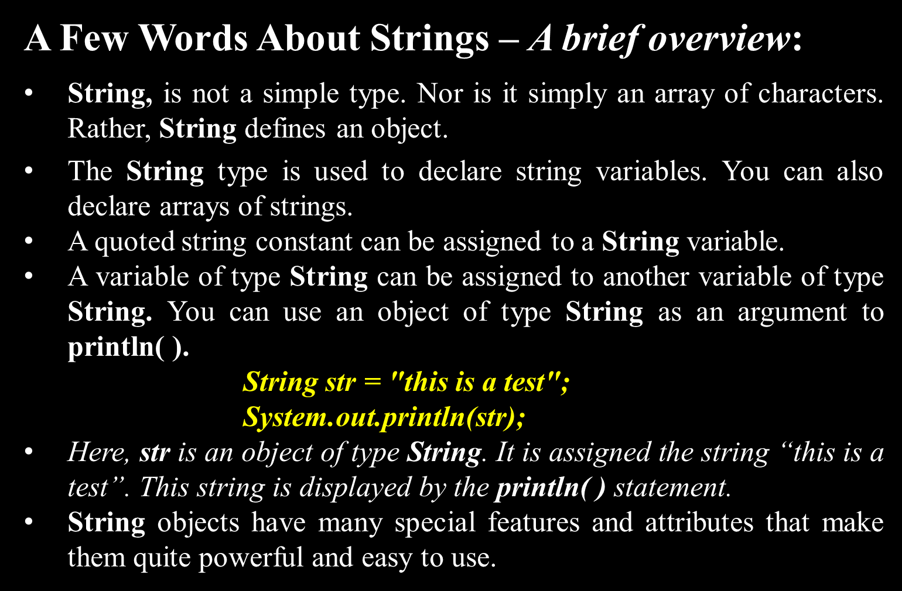

Slide 4
Overview:
As is the case in most other programming languages, in Java a string is a sequence of characters. But, unlike many other languages that implement strings as character arrays, Java implements strings as objects of type String.
Implementing strings as built-in objects allows Java to provide a full complement of features that make string handling convenient.
For example, Java has methods to compare two strings, search for a substring, concatenate two strings, and change the case of letters within a string.

Slide 5
Overview: ...
Once a String object has been created, you cannot change the characters that comprise that string. You can still perform all types of string operations.
Each time you need an altered version of an existing string, a new String object is created that contains the modifications. The original string is left unchanged(Immutable).
Immutable strings can be implemented more efficiently than changeable ones(Mutable).
Java provides two options: StringBuffer and StringBuilder. Both hold strings that can be modified after they are created.

Slide 6
Overview: ...
The String, StringBuffer, and StringBuilder classes are defined in java.lang, they are available to all programs automatically. All are declared final, (none of these classes may be sub-classed)
One last point: The strings within objects of type String are unchangeable means that the contents of the String instance cannot be changed after it has been created. However, a variable declared as a String reference can be changed to point at some other String object at any time.

Slide 7
Overview: ...
String is a sequence of characters.
Java implements strings as objects of type String.
It belongs to java.lang (java.lang.String)
Once a String object is created, it is not possible to change the characters that comprise the string.
When a modifiable string is needed, java provides two options:
    java.lang.StringBuffer
    java.lang.StringBuilder

Slide 8
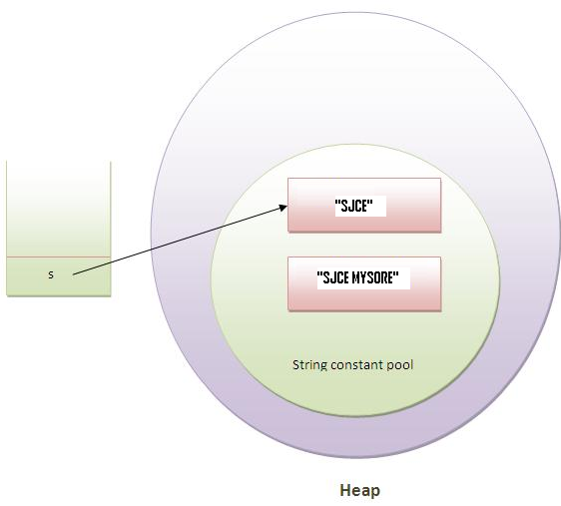
Overview: ...
class Simple{
  public static void main(String args[]){
    String s = "SJCE";
    s.concat(" MYSORE");
    // s = s.concat(" MYSORE");
    System.out.println(s);
  }
}
Why string objects are immutable in java?
Because java uses the concept of string literal. Suppose there are 5 reference variables, all refers to one object "SJCE". If one reference variable changes the value of the object, it will be affected to all the reference variables. That is why string objects are immutable in java.

Slide 9
The String Constructors:
The String class supports several constructors.
To create an empty String, you call the default constructor.
Eg: String s = new String(); // instance with no characters
To create strings that have initial values by an array of characters, String(char chars[ ])
Eg:
      char chars[] = { 'a', 'b', 'c' };
      String s = new String(chars);
      Specify a sub-range of a character array as an initializer using, String(char chars[ ], int startIndex, int numChars)

Slide 10
The String Constructors: ...
      specify a sub-range...
        Eg: char chars[] = { 'a', 'b', 'c', 'd', 'e', 'f' };
      String s = new String(chars, 2, 3);
To construct a String object that contains the same character sequence as another String object using, String(String strObj)
    // Construct one String from another.
    class MakeString {
      public static void main(String args[]) {
        char c[] = {'J', 'a', 'v', 'a'};
        String s1 = new String(c);
        String s2 = new String(s1);
        System.out.println(s1);
        System.out.println(s2);
      }
    }

Slide 11
The String Constructors: ...
Even though Java’s char type uses 16 bits to represent the basic Unicode character set, the typical format for strings on the Internet uses arrays of 8-bit bytes constructed from the ASCII character set.
Because 8-bit ASCII strings are common, the String class provides constructors that initialize a string when given a byte array. Their forms are shown here:
    String(byte asciiChars[ ])
    String(byte asciiChars[ ], int startIndex, int numChars)
Here, asciiChars specifies the array of bytes. The second form allows you to specify a sub-range.
In each of these constructors, the byte-to-character conversion is done by using the default character encoding of the platform.

Slide 12
The String Constructors: ...
8-bit ASCII strings....
  // Construct string from subset of char array.
  class SubStringCons {
    public static void main(String args[]) {
      byte ascii[] = {65, 66, 67, 68, 69, 70 };
      String s1 = new String(ascii);
      System.out.println(s1);
      String s2 = new String(ascii, 2, 3);
      System.out.println(s2);
    }
  }
  NOTE :The contents of the array are copied whenever you create a String object from an array. If you modify the contents of the array after you have created the string, the String will be unchanged.
You can construct a String from a StringBuffer by using the constructor, String(StringBuffer strBufObj)

Slide 13
The String Constructors: ...
To create an empty String, you call the default constructor, String();
String s = new String();
To create strings that have initial values by an array of characters, String(char chars[ ])
To specify a sub-range of a character array as an initializer using, String(char chars[ ], int startIndex, int numChars)
To construct a String object that contains the same character sequence as another String object using,
  String(String strObj)
The String class provides constructors that initialize a string when given a byte array. Their forms are shown here: String(byte asciiChars[ ])
    String(byte asciiChars[ ], int startIndex, int numChars)
To construct a String from a StringBuffer by using the constructor, String(StringBuffer strBufObj)

Slide 14
String Length:
The length of a string is the number of characters that it contains.
To obtain this value, call the length( ) method, shown here:
int length( )
Eg:
      char chars[] = { 'a', 'b', 'c' };
      String s = new String(chars);
      System.out.println(s.length()); // What is the Size?

Slide 15
Special String Operations:
Because strings are a common and important part of programming, Java has added special support for several string operations within the syntax of the language.
Operations include the automatic creation of new String instances from string literals, concatenation of multiple String objects by use of the + operator, and the conversion of other data types to a string representation.
There are explicit methods available to perform all of these functions, but Java does them automatically as a convenience for the programmer and to add clarity.

Slide 16
Special String Operations: ...
String Literals: Explicitly create a String instance using a string literal. Thus, you can use a string literal to initialize a String object.
    char chars[] = { 'a', 'b', 'c' };
    String s1 = new String(chars);
    String s2 = "abc"; // use string literal
Because a String object is created for every string literal, you can use a string literal any place you can use a String object.
System.out.println("abc".length());

Slide 17
Special String Operations: ...
String Concatenation: In general, Java does not allow operators to be applied to String objects. The one exception to this rule is the + operator, which concatenates two strings, producing a String object as the result. This allows you to chain together a series of + operations.
    String age = "9";
    String s = "He is " + age + " years old.";
    System.out.println(s);

Slide 18
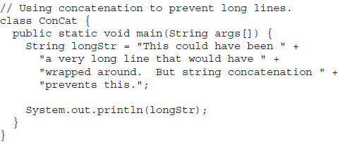
Special String Operations: ...
String Concatenation: ...
One practical use of string concatenation is found when you are creating very long strings. Instead of letting long strings wrap around within your source code, you can break them into smaller pieces, using the + to concatenate them.

Slide 19
Special String Operations: ...
String Concatenation with other Data Types:
  int age = 9;
  String s = "He is " + age + " years old.";
  System.out.println(s);
The compiler will convert an operand to its string equivalent whenever the other operand of the + is an instance of String.
Be careful when you mix other types of operations with string concatenation expressions.
  String s = "four: " + 2 + 2;
  System.out.println(s); // Output: ...
        String s = "four: " + (2 + 2); // Output: ...

Slide 20
Special String Operations: ...
String Conversion and toString( ):
When Java converts data into its string representation during concatenation, it does so by calling one of the overloaded versions of the string conversion method valueOf( ) defined by String.
valueOf( ) is overloaded for all the simple types and for type Object.
For the simple types, valueOf( ) returns a string that contains the human-readable equivalent of the value with which it is called. For objects, valueOf( ) calls the toString( ) method on the object.
Every class implements toString( ) because it is defined by Object.
For most important classes that you create, you will want to override toString( ) and provide your own string representations.
The toString( ) method has this general form: String toString( )

Slide 21
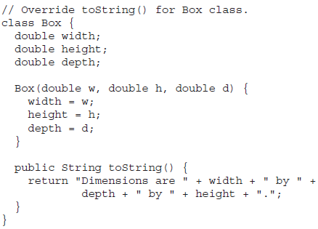
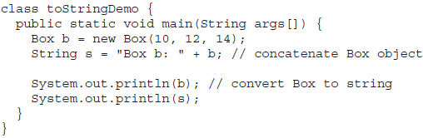
Special String Operations: ...
String Conversion and toString( ): ....
Box’s toString( ) method is automatically invoked when a Box object is used in a concatenation expression or in a call to println( ).

Slide 22
Character Extraction:
The String class provides a number of ways in which characters can be extracted from a String object.
charAt( ): To extract a single character from a String, you can refer directly to an individual character.
  char charAt(int where)
  Eg: char ch; ch = “abc”.charAt(1); // b is extracted
getChars( ): To extract more than one character at a time.
void getChars(int sourceStart, int sourceEnd,
  char target[ ], int targetStart)

Slide 23
Character Extraction: ...
getChars( ): ...
class getCharsDemo {
  public static void main(String args[]) {
    String s = "This is a demo of the getChars method.";
    int start = 10;
    int end = 14;
    char buf[] = new char[end - start];
    s.getChars(start, end, buf, 0);
    System.out.println(buf);
  }
}
getBytes( ) : Alternative to getChars( ) that stores the characters in an array of bytes. It uses the default character-to-byte conversions provided by the platform.
byte[ ] getBytes( )
most useful when you are exporting a String value into an environment that does not support 16-bit Unicode characters. Eg: Most Internet protocols and text file formats use 8-bit ASCII for all text interchange.

Slide 24
Character Extraction: ...
toCharArray( ): Converts all the characters in a String object into a character array, it returns an array of characters for the entire string. char[ ] toCharArray( )
This function is provided as a convenience, since it is possible to use getChars( ) to achieve the same result.

Slide 25
String Comparison:
The String class includes several methods that compare strings or substrings within strings.
equals( ) and equalsIgnoreCase( ): To compare two strings for equality.
    equals( ) //case-sensitive
    boolean equals(Object str)
    equalsIgnoreCase( ) //ignores case differences
    boolean equalsIgnoreCase(String str)

Slide 26
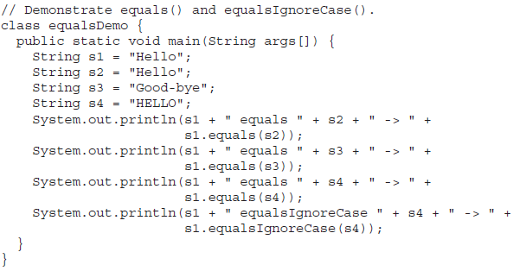
String Comparison: ...
equals( ) and equalsIgnoreCase( ): ...

Slide 27
String Comparison: ...
regionMatches( ):
boolean regionMatches(int startIndex, String str2,
int str2StartIndex, int numChars)
boolean regionMatches(boolean ignoreCase,
int startIndex, String str2,
int str2StartIndex, int numChars)
For both versions, startIndex specifies the index at which the region begins within the invoking String object. The String being compared is specified by str2. The index at which the comparison will start within str2 is specified by str2StartIndex. The length of the substring being compared is passed in numChars.
In the second version, if ignoreCase is true, the case of the characters is ignored. Otherwise, case is significant.

Slide 28
String Comparison: ...
startsWith( ) and endsWith( ): Specialized forms of regionMatches( ). These methods determines whether a given String begins/ends with a specified string.
    boolean startsWith(String str)
    boolean endsWith(String str)
    boolean startsWith(String str, int startIndex)
    Eg:
      "Foobar".endsWith("bar")
      "Foobar".startsWith("Foo")
      "Foobar".startsWith("bar", 3)

Slide 29
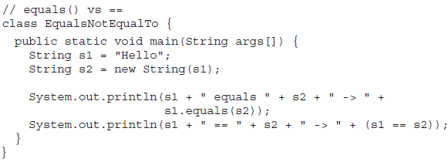
String Comparison: ...
equals( ) Versus ==( )
The equals( ) method compares the characters inside a String object.
The == operator compares two object references to see whether they refer to the same instance.

Slide 30
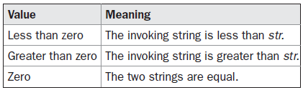
String Comparison: ...
compareTo( ): It is not enough to simply know whether two strings are identical. For sorting applications, you need to know which is less than, equal to, or greater than the next. A string is less than another if it comes before the other in dictionary order. A string is greater than another if it comes after the other in dictionary order.
int compareTo(String str)

Slide 31
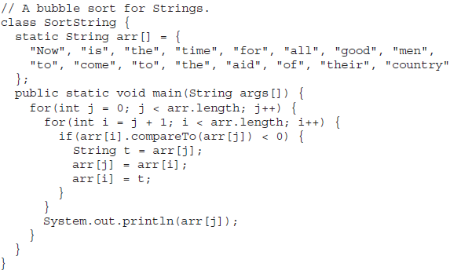
String Comparison: ...
compareTo( ): An Exmaple

Slide 32
Searching Strings:
The String class provides two methods that allow you to search a string for a specified character or substring:
  indexOf( ) Searches for the first occurrence of a character or substring.
  lastIndexOf( ) Searches for the last occurrence of a character or substring.
These two methods are overloaded in several different ways.
In all cases, the methods return the index at which the character or substring was found, or –1 on failure.

Slide 33
Searching Strings: ...
To search for the first/last occurrence of a character, use
      int indexOf(int ch)
      int lastIndexOf(int ch)
To search for the first/last occurrence of a substring, use
      int indexOf(String str)
      int lastIndexOf(String str)
You can specify a starting point for the search using
      int indexOf(int ch, int startIndex)
      int lastIndexOf(int ch, int startIndex)
      int indexOf(String str, int startIndex)
      int lastIndexOf(String str, int startIndex)
Here, startIndex specifies the index at which point the search begins. For indexOf( ), the search runs from startIndex to the end of the string. For lastIndexOf( ), the search runs from startIndex to zero.

Slide 34
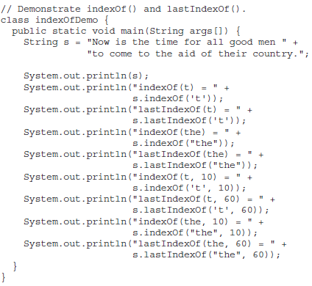
Searching Strings: ...An Example

Slide 35
Modifying Strings:
Because String objects are immutable, whenever you want to modify a String, you must either copy it into a StringBuffer or StringBuilder, or use one of the following String methods, Which will construct a new copy of the string with your modifications complete.
substring( ): To extract a substring use, substring( ).
It has two forms:
        String substring(int startIndex)
        String substring(int startIndex, int endIndex)
Here, startIndex specifies the beginning index, and endIndex specifies the stopping point. The string returned contains all the characters from the beginning index, up to, but not including, the ending index.

Slide 36
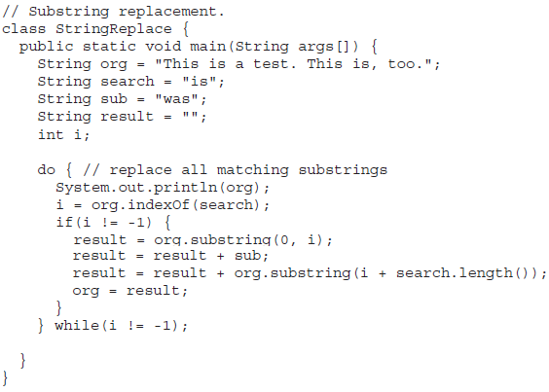
Modifying Strings: ... The following program uses substring( ) to replace all instances of one substring with another within a string:

Slide 37
Modifying Strings: ...
concat( ): To concatenate two stings use, String substring( ), performs the same function as +.
Eg:
    String s1 = "one";
    String s2 = s1.concat("two"); // String s2 = s1 + "two";
replace( ): To replaces all occurrences of one character in the invoking string with another character.
String replace(char original, char replacement)
Eg: String str = “NEW".replace(‘E', ‘O');
The second form of replace( ) replaces one character sequence with another. It has this general form:
String replace(CharSequence original, CharSequence replacement)
This form was added by J2SE 5.

Slide 38
Modifying Strings: ...
trim( ): returns a copy of the invoking string from which any leading and trailing whitespace has been removed.
String trim( )
Eg: String s = " Hello World ".trim();

Slide 39
StringBuffer:
StringBuffer is a peer class of String that provides much of the functionality of strings.
String represents fixed-length, immutable character sequences. In contrast,
StringBuffer represents growable and writeable character sequences.
StringBuffer may have characters and substrings inserted in the middle or appended to the end.
StringBuffer will automatically grow to make room for such additions and often has more characters pre-allocated than are actually needed, to allow room for growth.

Slide 40
StringBuffer: ... StringBuffer Constructors
StringBuffer defines these four constructors:
StringBuffer( ): Reserves room for 16 characters without reallocation.
StringBuffer(int size): Accepts an integer argument that explicitly sets the size of the buffer.
StringBuffer(String str): Accepts a String argument that sets the initial contents of the StringBuffer object and reserves room for 16 more characters without reallocation.
StringBuffer(CharSequence chars): Creates an object that contains the character sequence contained in chars.
StringBuffer allocates room for 16 additional characters when no specific buffer length is requested, because reallocation is a costly process in terms of time. Also, frequent reallocations can fragment memory. By allocating room for a few extra characters, StringBuffer reduces the number of reallocations that take place.

Slide 41

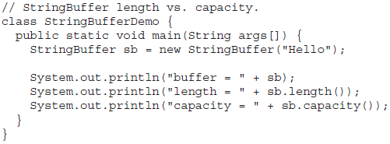

Since sb is initialized with the string “Hello” when it is created, its length is 5. Its capacity is 21 because room for 16 additional characters is automatically added.

Slide 42
StringBuffer: ... Some useful methods
charAt( ) and setCharAt( )
    char charAt(int where)
    void setCharAt(int where, char ch)
getChars( )
    void getChars(int sourceStart, int sourceEnd,
    char target[ ], int targetStart)
append( )
    StringBuffer append(String str)
    StringBuffer append(int num)
    StringBuffer append(Object obj)

Slide 43
StringBuffer: ... Some useful methods
insert( )
    StringBuffer insert(int index, String str)
    StringBuffer insert(int index, char ch)
    StringBuffer insert(int index, Object obj)
reverse( ): StringBuffer reverse( )
delete( ) and deleteCharAt( )
    StringBuffer delete(int startIndex, int endIndex)
    StringBuffer deleteCharAt(int loc)
    replace( ):
    StringBuffer replace(int startIndex, int endIndex, String str)
replace( ): String substring(int startIndex)
String substring(int startIndex, int endIndex)

Slide 44
StringBuilder:
J2SE 5 adds a new string class to Java’s already powerful string handling capabilities, called StringBuilder.
It is identical to StringBuffer except for one important difference: it is not synchronized, which means that it is not thread-safe.
The advantage of StringBuilder is faster performance.
However, in cases in which you are using multithreading, you must use StringBuffer rather than StringBuilder.

Slide 45
Concept of Mutable and Immutable String:
Java's String is designed to be immutable i.e, once a String is constructed, its contents cannot be modified.
The Strings within objects of type String are unchangeable means the content of the String instance cannot be changes after it has been created. However, a variable declared as a String reference can be changed to point at some other String object at any time.

Slide 46
Concept of Mutable and Immutable String:...
The StringBuffer and StringBuilder classes are used when there is a necessity to make a lot of modifications to Strings of characters. (Mutable)
The String, StringBuffer and StringBuilder classes are defined in java.lang

Slide 47
Command -line arguments:
Sometimes you will want to pass information into a program when you run it. This is accomplished by passing command-line arguments to main( ).
It is the information that directly follows the program’s name on the command line when it is executed.
To access the command-line arguments inside a Java program is quite easy - they are stored as strings in a String array passed to the args parameter of main( ). The first command-line argument is stored at args[0], the second at args[1], and so on.
REMEMBER All command-line arguments are passed as strings. You must convert numeric values to their internal forms manually.

Slide 48
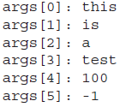
Command -line arguments: ...Example
// Display all command-line arguments.
class CommandLine {
  public static void main(String args[]) {
    for(int i=0; i<args.length; i++)
    System.out.println("args[" + i + "]: " + args[i]);
  }
}
javac CommandLine.java
java CommandLine this is a test 100 -1

Slide 49
Basics of I/O operations: Keyboard input using BufferedReader class
In Java, console input is accomplished by reading from System.in. To obtain a character-based stream that is attached to the console, wrap System.in in a BufferedReader object.
BufferedReader supports a buffered input stream. Its most commonly used constructor is shown here:
BufferedReader(Reader inputReader)
Here, inputReader is the stream that is linked to the instance of BufferedReader that is being created. Reader is an abstract class.
One of its concrete subclasses is InputStreamReader, which converts bytes to characters. To obtain an InputStreamReader object that is linked to System.in, use the following constructor:
InputStreamReader(InputStream inputStream)

Slide 50
Basics of I/O operations: Keyboard input using BufferedReader class...
Because System.in refers to an object of type InputStream, it can be used for inputStream.
Putting it all together, the following line of code creates a BufferedReader that is connected to the keyboard:
    BufferedReader br = new BufferedReader(new
    InputStreamReader(System.in));
After this statement executes, br is a character-based stream that is linked to the console through System.in.
Reading Characters: To read a character from a BufferedReader, use read( ). The version of read( ) that we will be using is
int read( ) throws IOException

Slide 51
Basics of I/O operations: Keyboard input using BufferedReader class...
int read( ) throws IOException...Example
  // Use a BufferedReader to read characters from the console.
  import java.io.*;
  class BRRead {
    public static void main(String args[])
    throws IOException
    {
      char c;
      BufferedReader br = new BufferedReader(new InputStreamReader(System.in));
      System.out.println("Enter characters, 'q' to quit.");
      // read characters
      do {
        c = (char) br.read();
        System.out.println(c);
      } while(c != 'q');
    }
  }

Slide 52
Basics of I/O operations: Keyboard input using BufferedReader class...
Declaration: public class BufferedReader extends Reader
Class constructors
BufferedReader(Reader in) : Create a new BufferedReader that will read from the specified subordinate stream with a default buffer size of 8192 chars.
BufferedReader(Reader in, int size) : Create a new BufferedReader that will read from the specified subordinate stream with a buffer size that is specified by the caller.

Slide 53
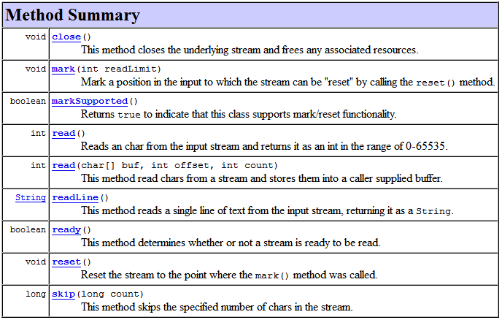
Basics of I/O operations: Keyboard input using BufferedReader class...

Slide 54
Basics of I/O operations:
Keyboard input using Scanner class:
It is the complement of Formatter, reads formatted input and converts it into its binary form.
Read all types of numeric values, strings, and other types of data, whether it comes from a disk file, the keyboard, or another source.
Scanner can be used to read input from the console, a file, a string, or any source that implements the Readable interface or ReadableByteChannel.

Slide 55
Basics of I/O operations:
Keyboard input using Scanner class:...
The Scanner Constructors
Scanner defines the constructors, it can be created for a String, an InputStream, a File, or any object that implements the Readable or ReadableByteChannel interfaces.
Eg: The following sequence creates a Scanner that reads the file Test.txt:
    FileReader fin = new FileReader("Test.txt");
    Scanner src = new Scanner(fin);

Slide 56
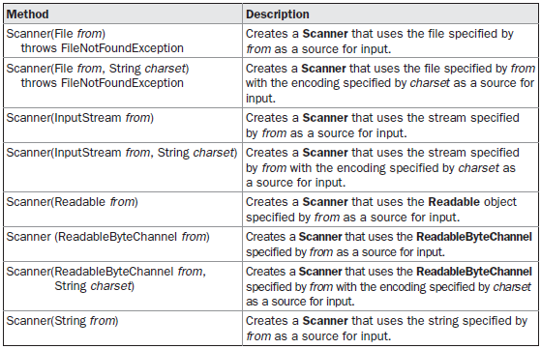
Basics of I/O operations:
Keyboard input using Scanner class:...
The Scanner Constructors...

Slide 57
Basics of I/O operations:
Keyboard input using Scanner class:...
Scanning Basics
Once you have created a Scanner, it is a simple matter to use it to read formatted input. It reads tokens from the underlying source that you specified when the Scanner was created.
As it relates to Scanner, a token is a portion of input that is delineated by a set of delimiters, which is whitespace by default.

Slide 58
Basics of I/O operations:
Keyboard input using Scanner class:...
Scanning Basics...
In general, to use Scanner, follow this procedure:
Determine if a specific type of input is available by calling one of Scanner’s hasNextX methods, where X is the type of data desired.
If input is available, read it by calling one of Scanner’s nextX methods.
Repeat the process until input is exhausted.
The following sequence shows how to read a list of integers from the keyboard.
      Scanner conin = new Scanner(System.in);
      int i;
      // Read a list of integers.
      while(conin.hasNextInt()) {
        i = conin.nextInt();
        // ...
      }

Slide 59
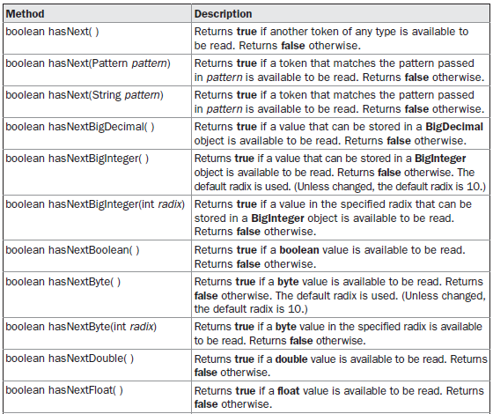
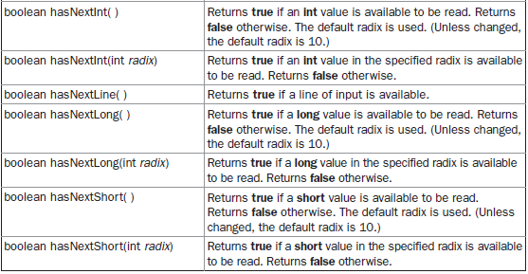
Basics of I/O operations:
Keyboard input using Scanner class:...
Scanning Basics... The Scanner hasNext Methods

Slide 60
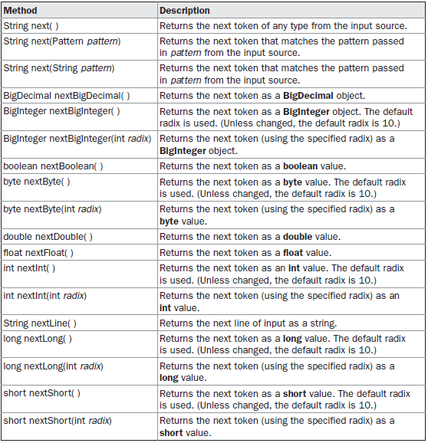
Basics of I/O operations:
Keyboard input using
Scanner class:...
Scanning Basics...
The Scanner next
Methods

